Slide 1

Increasing Sales
Know your customer to increase revenue

Slide 2
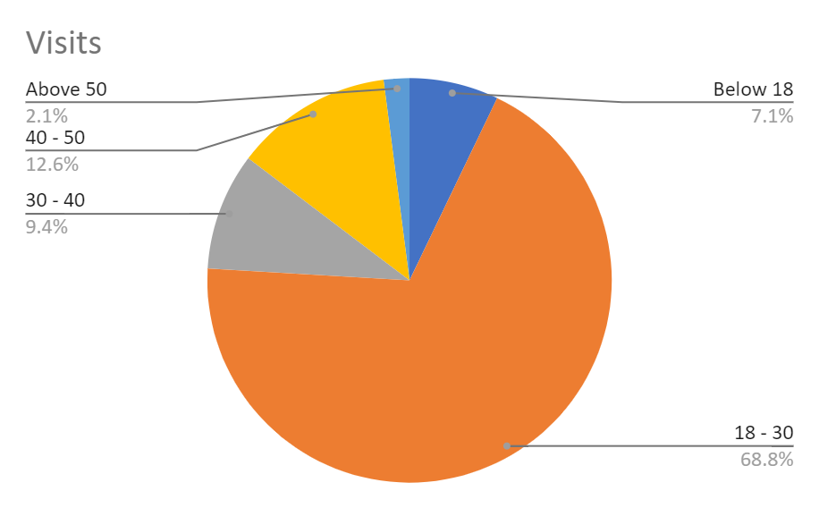
Distribution of customers w.r.t visits
Highest
- (18 - 30)
- Lowest
- (above 50)

Slide 3
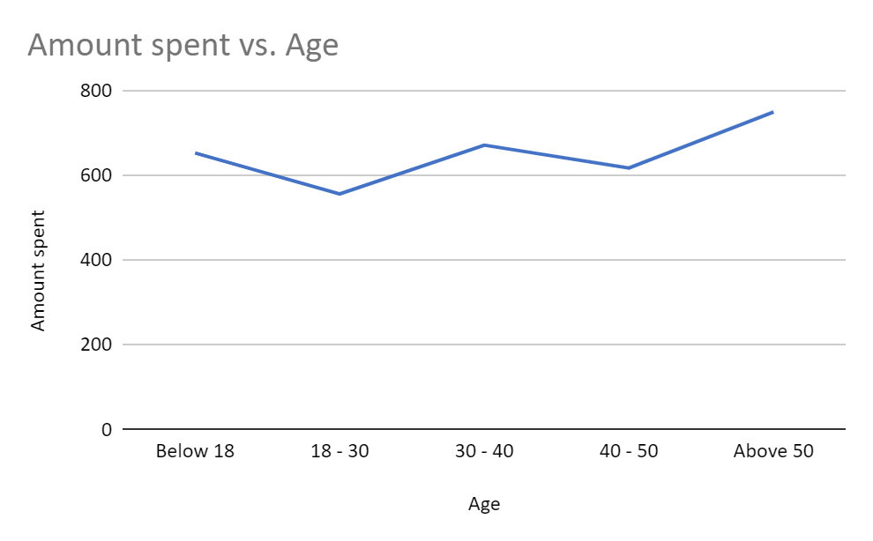
Distributions w.r.t spendings
Maximum
- above 50
- Minimum
- 18-30

Slide 4

Recommendation
Above 50
- Spends a lot.
- Visits the store very rarely.
- Incentivise them to visit the store frequently.
- Offer time limited discounts
- Between 18-30
- Visit the store a lot
- Spend less
- Incentivise them to spend more.
- offer discounts. For example - Buy 1 Get one free

